Slide 1
IPv6 Addressing
Computer Networks
Lecture 3

Slide 2
Why IPv6
IPv4 has a theoretical maximum of 4.3 billion addresses
plus private addresses in combination with NAT
NAT having limitations in peer-to-peer communications
With an Internet of things, devices other than computers, tablets, and smartphones, sensors, Internet-ready devices, automobiles, biomedical devices, household appliances, natural ecosystems etc… need to connect to the internet.

Slide 3
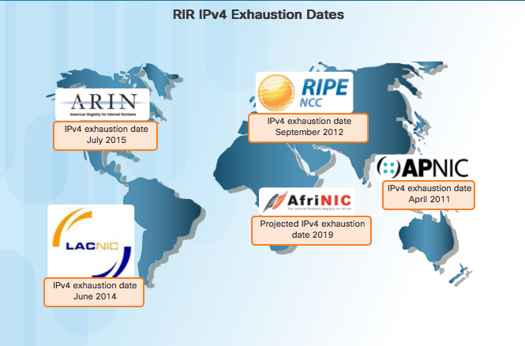
Why IPv6

Slide 4
How it looks like
IPv6 has a larger 128-bit address space
340 undecillion addresses. (That is the number 340, followed by 36 zeroes.)
When the IETF began its development of a successor to IPv4, so it fix the limitations of IPv4 and include additional enhancements
Ex- 2001:0DB8:0000:1111:0000:0000:0000:0200
Hextet used to refer to a segment of 16 bits or four hexadecimals

Slide 5
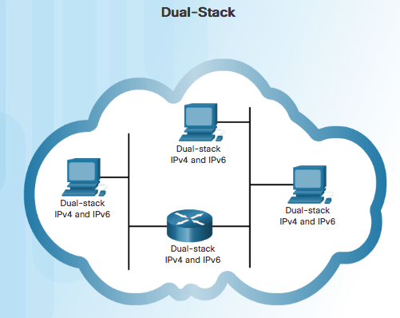
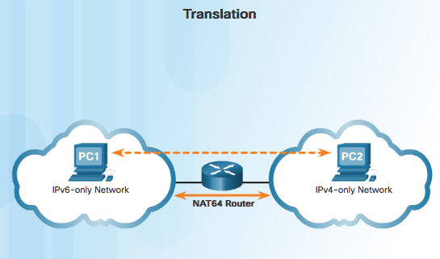
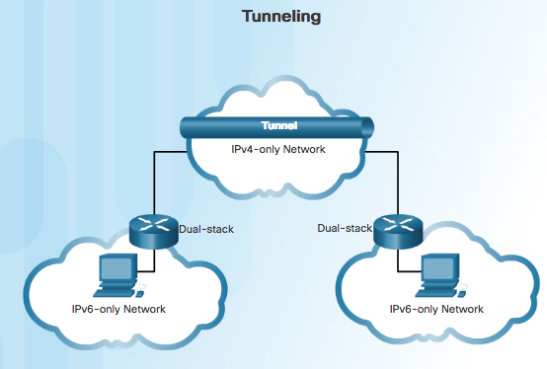
IPv4 and IPv6 Coexistence
Dual Stack –dual stack allows IPv4 and IPv6 to coexist on the same network segment. Dual stack devices run both IPv4 and IPv6 protocol stacks simultaneously.
Tunneling –tunneling is a method of transporting an IPv6 packet over an IPv4 network. The IPv6 packet is encapsulated inside an IPv4 packet, similar to other types of data.
Translation – Network Address Translation 64 (NAT64) allows IPv6-enabled devices to communicate with IPv4-enabled devices using a translation technique similar to NAT for IPv4. An IPv6 packet is translated to an IPv4 packet and vice versa.

Slide 6
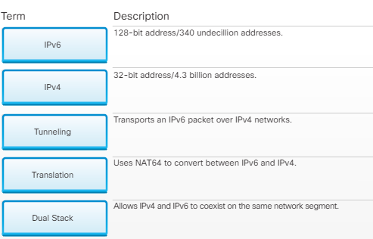

Slide 7
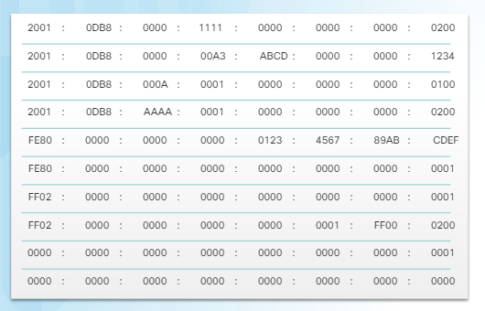
Address formats

Slide 8





IPv6 Address - Rule 1 (Omitting Leading 0s)
The first rule to help reduce the notation of IPv6 addresses is any leading 0s (zeros) in any 16-bit section or hextet can be omitted
01AB can be represented as 1AB
09F0 can be represented as 9F0
0A00 can be represented as A00
00AB can be represented as AB

Slide 9
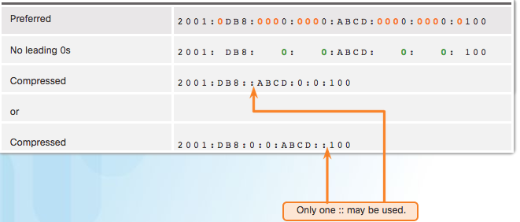
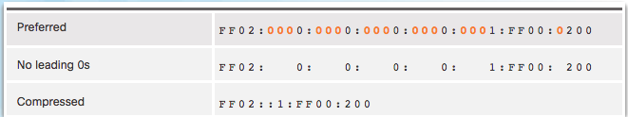
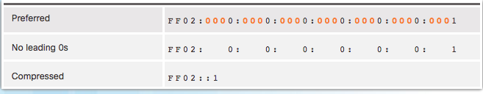
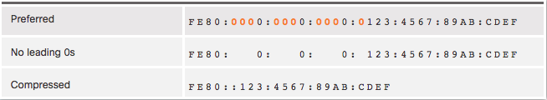
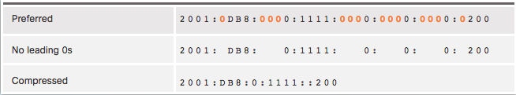
IPv6 Address -Rule 2 (Omitting All 0 Segments)
A double colon (::) can replace any single, contiguous string of one or more 16-bit segments (hextets) consisting of all 0’s
Double colon (::) can only be used once within an address otherwise the address will be ambiguous
Known as the compressed format
2001:0DB8::ABCD:0000:0000:1234
2001:0DB8::ABCD:0000:0000:0000:1234
2001:0DB8:0000:ABCD::1234
2001:0DB8:0000:0000:ABCD::1234

Slide 10
IPv6 Address Types
There are three types of IPv6 addresses:
Unicast
Multicast
Anycast
*** IPv6 does not have broadcast addresses.

Slide 11
IPv6 Unicast Addresses
Global unicast
Similar to a public IPv4 address.
Globally unique, Internet routable addresses.
Global unicast addresses can be configured statically or assigned dynamically.
Currently, only global unicast addresses with the first three bits of 001 or 2000::/3 are being assigned. (The first hextet has a range of (2000) to (3FFF).
Link-local
Link-local addresses are used to communicate with other devices on the same local link. (The first hextet has a range of (FE80) to (FEBF).)
Unique local
Similar to the private addresses for IPv4, but there are significant differences.
(FC00::/7 to FDFF::/7)
*** 2001:0DB8::/32 address has been reserved for documentation purposes

Slide 12
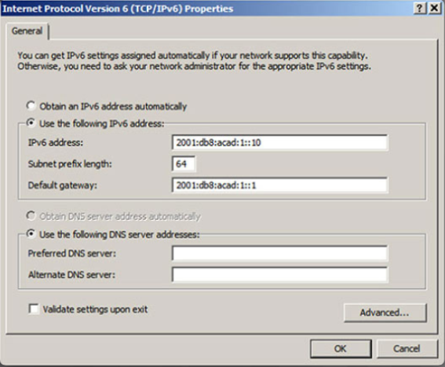
Host Configuration
Manually configuring the IPv6 address on a host is similar to configuring an IPv4 address.
the default gateway address configured for PC1 is 2001:DB8:ACAD:1::1. This is the global unicast address of the Router GigabitEthernet interface on the same network.
the default gateway address can be configured to match the link-local address of the GigabitEthernet interface of the router.

Slide 13
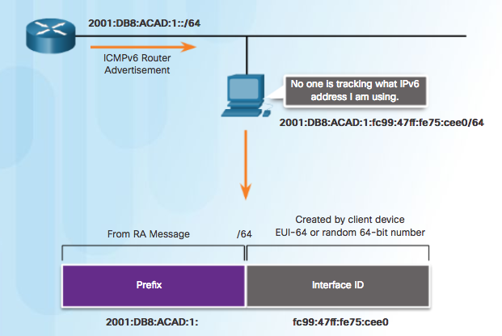
Dynamic Configuration - SLAAC
Stateless Address Autoconfiguration (SLAAC) is a method that allows a device to obtain its prefix, prefix length, default gateway address, and other information from an IPv6 router without the use of a DHCPv6 server.

Slide 14
EUI-64 Process
IEEE defined the Extended Unique Identifier (EUI) or modified EUI-64 process. This process uses a client’s 48-bit Ethernet MAC address, and inserts another 16 bits in the middle of the 48-bit MAC address to create a 64-bit Interface ID.
Step 1: Divide the MAC address between the OUI and device identifier.
Step 2: Insert the hexadecimal value FFFE, which in binary is: 1111 1111 1111 1110
Step 3: Convert the first 2 hexadecimal values of the OUI to binary and flip the U/L bit (bit 7). In this example, the 0 in bit 7 is changed to a 1

Slide 15
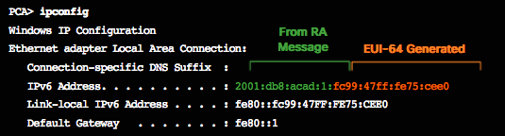
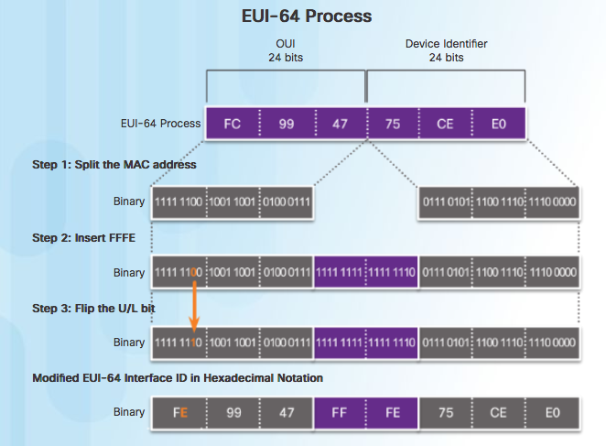

Slide 16
Questions ?

